Slide 1
Cyclistic Analysis Report
Presented by - Sanjay S A Last updated - 20/12/2020

Slide 2
What are we talking about?
What is the goal of this analysis?

Slide 3
How to maximise annual membership
Providing discount on membership plans during weekends.
As the number of casual rides in weekends is higher by roughly 45%.
Providing special discounts to members only on weekend rides.
The average ride duration of casual riders is higher by roughly 32%.
Following festive trends in Chicago to establish campaign to promote cyclistic.
Number of rides in festivals month are high by 50-55%.
Solutions
Quotes for illustration purposes only

Slide 4

Overview
Objective What are we talking about?
Analytical insights Findings from the data.
Conclusion Tips for approaching business goal.

Slide 5
Objective
Maximising annual memberships.
How casual riders differ from members ?
Why would casual riders buy cyclistic annual membership ?
How to promote membership ?

Slide 6
How casual riders differ from members ?

Slide 7
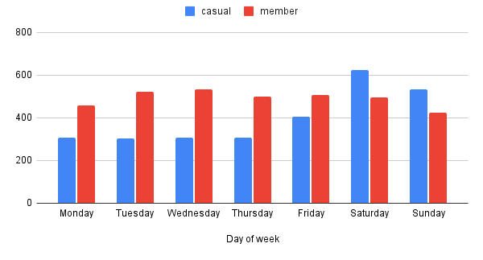
Here we can see the number of rides of casual riders increase towards the end of week
However the annual members number of rides throught the week almost stayed the same
No of rides throught the days of week
Conclusion : the number of casual rides in weekends is higher by roughly 45%.

Slide 8
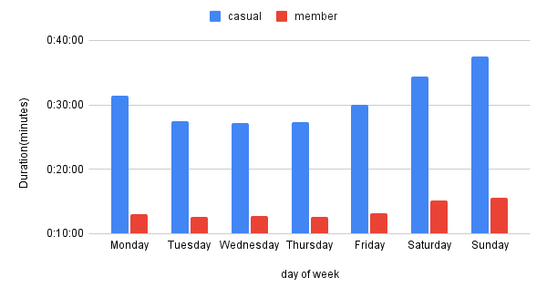
Average ride duration of casual rider high and goes higher towards the end of week by roughly 32%.
Average ride duration of member is low however the ride length increases towards the end of week .
Average ride length of casual and members throught the days of week
Conclusion : The average ride duration of casual riders is higher by roughly 32%.

Slide 9
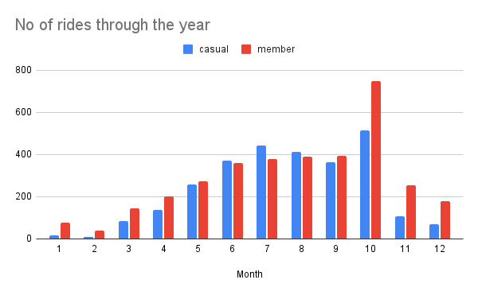
The number of rides gradually grew in the months festivals and events (around Chicago).
The number of casual riders have increased in these months.
Number of rides through the year by months.
Conclusion : Number of rides in festivals month are high by 50-55%.

Slide 10
Other findings that might help increase memberships.

Slide 11
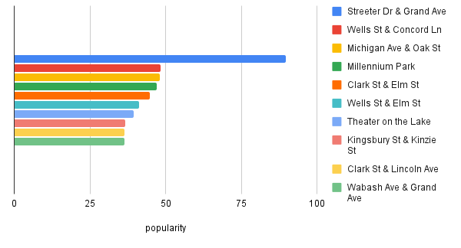
Popular end stations
Ordered
Conclusion : Establishing campaigns around these stations to promote cyclistic.

Slide 12
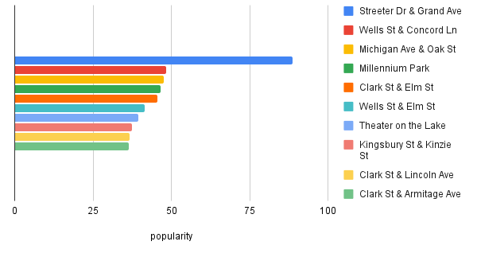
Popular start stations
Ordered
Conclusion : Establishing campaigns around these stations to promote cyclistic.

Slide 13
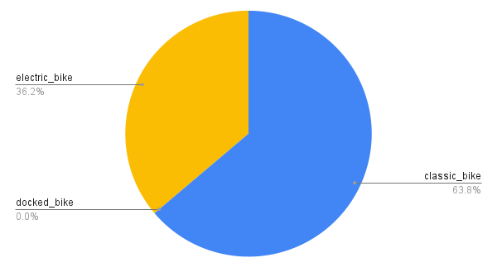
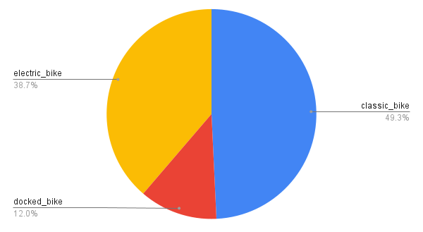
Popularity of rideable types
Conclusion : Decommissioning unpopular ride types or promoting those ride types.

Slide 14
Any Questions ?

